Slide 1
Testing
Introduction
  After detailed design, the coding and integration will begin.
  The source code for each is written and tested.
  The modules are brought together (Integrated) to form the system and tested.

Slide 2
What is testing?
Testing is not showing that there are no errors in the program.
Testing cannot show that the program performs its intended goal correctly.
So, what is testing?
Testing is the process of executing the program in order to find errors.
A successful test is one that finds an error.

Slide 3
Testing
testing: systematic attempt to reveal the presence of errors (to "falsify" system)
  accomplished by exercising defects in the system and revealing problems
    failed test: an error was demonstrated
    passed test: no error was found, so far
  not used to show absence of errors in software
  does not directly reveal the actual bugs in the code
What is the overall goal of testing? What claims can we make when testing "passes" or "fails" ? Can we prove that our code has no bugs?

Slide 4
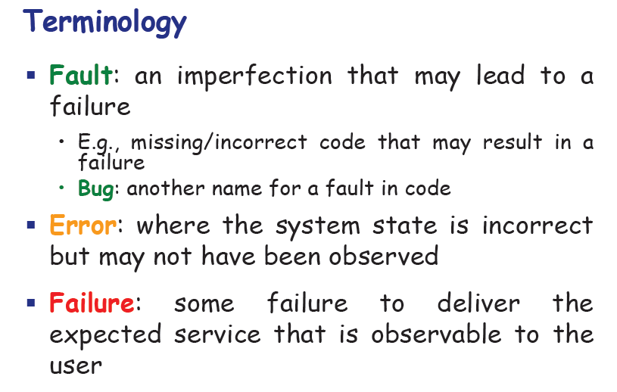
Software Testing Fundamentals
Definition 1:Testing is the process of establishing the existence of errors (it is different from Debugging!)
(The debugging is not testing, but always as a consequence of testing. The debugging process attempts to match symptom with cause thereby leading to error correction)
Definition 2: Testing is the process of exercising a program with the specific intent of finding errors prior to delivery to the end user. (Pressman)
The main aim of testing is to find errors!
Testing cannot demonstrate the absence of errors. It can only demonstrate the presence of errors!

Slide 5
Program Testing
Testing a program consists of providing the program with a set of test inputs (or test cases) and observing if the program behaves as expected.
If the program fails to behave as expected, then the conditions under which failure occurs are noted for later debugging and correction.
Some commonly used terms associated with testing are:
Failure: This is a manifestation of an error (or defect or bug). But, the mere presence of an error may not necessarily lead to a failure.
Test case: This is the triplet [I,S,O], where I is the data input to the system, S is the state of the system at which the data is input, and O is the expected output of the system.
Test suite: This is the set of all test cases with which a given software product is to be tested.

Slide 6
Aim of Testing
The aim of the testing process is to identify all defects existing in a software product.
However for most practical systems, even after satisfactorily carrying out the testing phase, it is not possible to guarantee that the software is error free.
This is because of the fact that the input data domain of most software products is very large.
It is not practical to test the software exhaustively with respect to each value that the input data may assume.
Even with this practical limitation of the testing process, the importance of testing should not be underestimated
It must be remembered that testing does expose many defects existing in a software product. Thus testing provides a practical way of reducing defects in a system and increasing the users’ confidence in a developed system.

Slide 7

What Testing Shows
errors
requirements conformance
performance
an indication
of quality

Slide 8

Some testing principles
A programmer should not test his/her own program.
One should test not only that the program does what it is supposed to do, but that it does not do what it is not supposed to.
The goal of testing is to find errors, not to show that the program is errorless.
No amount of testing can guarantee error-free program.
Parts of programs where a lot of errors have already been found are a good place to look for more errors.
The goal is not to humiliate the programmer!

Slide 9
V & V
Verification refers to the set of tasks that ensure that software correctly implements a specific function.
Validation refers to a different set of tasks that ensure that the software that has been built is traceable to customer requirements. Boehm states this another way:
  Verification: "Are we building the product right?"
  Validation: "Are we building the right product?"

Slide 10
V vs V
Verification is the process of determining whether the output of one phase of software development conforms to that of its previous phase,
whereas validation is the process of determining whether a fully developed system conforms to its requirements specification.
Thus while verification is concerned with phase containment of errors, the aim of validation is that the final product be error free

Slide 11
The V & V Process
Is a whole life-cycle process - V & V must be
applied at each stage in the software process.
Has two principal objectives
  The discovery of defects in a system
  The assessment of whether or not the system is usable in
  an operational situation
CMSC 345, Version 4/04

Slide 12
Stages, Deliverables and V&V Activities
User requirements
Validate
Analysis
Validate
Working system
Requirements specification
Verify
Implemen-tation
Verify
Design
Design specification

Slide 13
V & V Goals
Verification and validation should establish confidence that the software is fit for its purpose.
  This does NOT mean completely free of defects.
  Rather, it must be good enough for its intended use. The type of use will determine the degree of confidence that is needed.
CMSC 345, Version 4/04

Slide 14
Static vs. Dynamic V & V
Code and document inspections - Concerned with the analysis of the static system representation to discover problems (static v & v)
Software testing - Concerned with exercising and observing product behavior (dynamic v & v)
  The system is executed with test data and its operational behavior is observed
CMSC 345, Version 4/04

Slide 15
Code Inspections (Static V & V)
Involves examining the source code with the aim of discovering anomalies and defects
Defects may be logical errors, anomalies in the code that might indicate an erroneous condition (e.g., an uninitialized variable), or non-compliance with coding standards.
Intended for defect detection, not correction
Very effective technique for discovering errors
Saves time and money – the earlier in the development process an error is found, the better
CMSC 345, Version 4/04

Slide 16
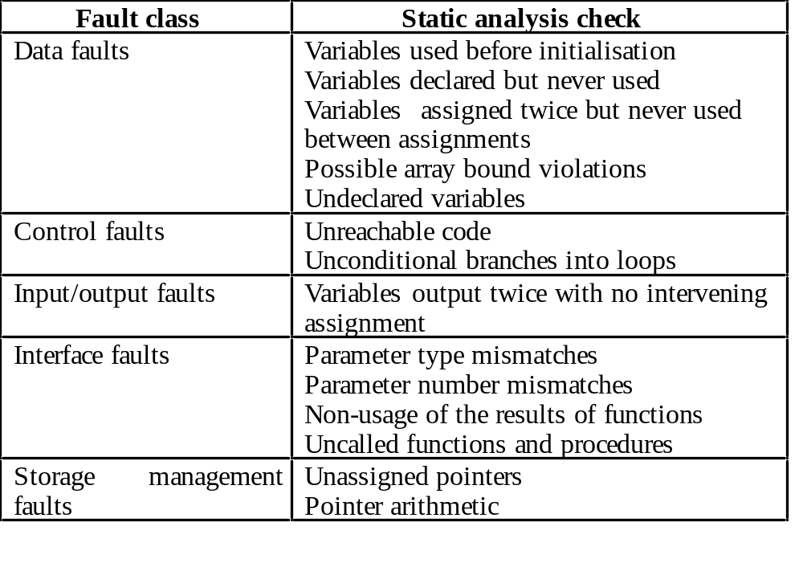
Static Analysis Checks
CMSC 345, Version 4/04

Slide 17
Stages of Static Analysis
Control flow analysis. Checks for loops with
multiple exit or entry points, finds unreachable code, etc.
Data use analysis. Detects uninitialized
variables, variables assigned twice without an intervening use, variables that are declared but never used, etc.
Interface analysis. Checks the consistency of procedure declarations and their use
CMSC 345, Version 4/04

Slide 18
Stages of Static Analysis (con’t)
Information flow analysis. Identifies the
dependencies of output variables. Does not
detect anomalies itself but highlights
information for code inspection or review
Path analysis. Identifies paths through the program and sets out the statements executed in that path. Potentially useful in the inspection and testing processes.
Both of these stages generate vast amounts of information. Must be used with care.
CMSC 345, Version 4/04

Slide 19


Who Tests the Software?
developer
independent tester
Understands the system
Must learn about the system,
but, will test "gently"
but, will attempt to break it
and, is driven by "delivery"
and, is driven by quality

Slide 20
Design of test cases
Exhaustive testing of almost any non-trivial system is impractical due to the fact that the domain of input data values to most practical software systems is either extremely large or infinite.
Therefore, we must design an optional test suite that is of reasonable size and can uncover as many errors existing in the system as possible.
Actually, if test cases are selected randomly, many of these randomly selected test cases do not contribute to the significance of the test suite, i.e. they do not detect any additional defects not already being detected by other test cases in the suite
Thus, the number of random test cases in a test suite is, in general, not an indication of the effectiveness of the testing.
Consider the following example code segment which finds the greater of two integer values x and y. This code segment has a simple programming error.

Slide 21
Design of test cases
If (x>y) max = x;
else max = x;
For the above code segment, the test suite, {(x=3,y=2);(x=2,y=3)} can detect the error, whereas a larger test suite {(x=3,y=2);(x=4,y=3);(x=5,y=1)} does not detect the error.
So, it would be incorrect to say that a larger test suite would always detect more errors than a smaller one, unless of course the larger test suite has also been carefully designed.
This implies that the test suite should be carefully designed than picked randomly.
Therefore, systematic approaches should be followed to design an optimal test suite. In an optimal test suite, each test case is designed to detect different errors.

Slide 22
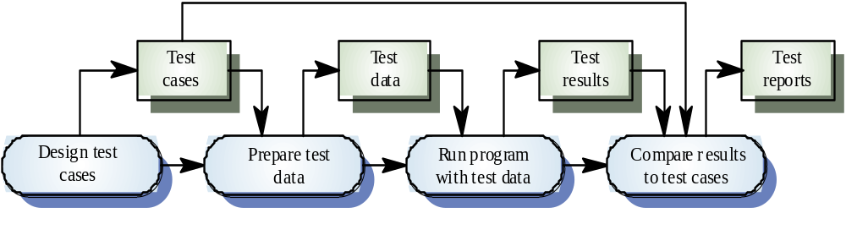
A model of software testing process

Slide 23
Who does Software Testing?
- Test manager
- manage and control a software test project
- supervise test engineers
- define and specify a test plan
- Software Test Engineers and Testers
- define test cases, write test specifications, run tests
- Independent Test Group
- Development Engineers
- Only perform unit tests and integration tests
- Quality Assurance Group and Engineers
- Perform system testing
- Define software testing standards and quality control process

Slide 24
Logical Organization of Testing
Component code
Unit test
Tested component
Component code
Unit test
Integration test
Integrated modules
System test
System in use
Ensures that all components work together
Component code
Unit test
Function test
Quality test
Acceptance test
Installation test
Ensure that each component works as specified
Verifies that functional requirements are satisfied
Verifies non-functional requirements
Customer verifies all requirements
Testing in user environment

Slide 25
Levels of Testing
What users
really need
Acceptance testing
Requirements
System testing
Design
Integration testing
Code
Unit testing
Maintenance
Regression Testing

Slide 26
COMPONENT/UNIT TESTING
Software Testing Process

Slide 27

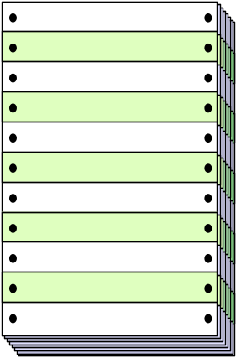
Unit Testing
module
to be
tested
results
software
engineer
test cases

Slide 28
Unit Testing (cont.)
module
to be
tested
interface
local data structures
boundary conditions
independent paths
error handling paths
test cases

Slide 29
Unit Test Environment
driver
interface
local data structures
Module
boundary conditions
independent paths
error handling paths
stub
stub
test cases
RESULTS
In computer science, test stubs are programs that simulate the behaviors of software components (or modules) that a module undergoing tests depends on

Slide 30
Unit testing
The most ‘micro’ scale of testing.
Tests done on particular functions or code modules.
Requires knowledge of the internal program design and code.
Done by Programmers (not by testers).
Srihari Techsoft

Slide 31
Unit testing
Objectives | To test the function of a program or unit of code such as a program or module To test internal logic To verify internal design To test path & conditions coverage To test exception conditions & error handling
When | After modules are coded
Input | Internal Application Design Master Test Plan Unit Test Plan
Output | Unit Test Report
Srihari Techsoft

Slide 32
Who | Developer
Methods | White Box testing techniques Test Coverage techniques
Tools | Debug Re-structure Code Analyzers Path/statement coverage tools
Education | Testing Methodology Effective use of tools
Srihari Techsoft

Slide 33
INTEGRATION TESTING
Software Testing Process

Slide 34
Why Integration Testing Is Necessary
One module can have an adverse effect on another
Subfunctions, when combined, may not produce the desired major function
Individually acceptable imprecision in calculations may be magnified to unacceptable levels

Slide 35
Why Integration Testing Is Necessary (cont’d)
Interfacing errors not detected in unit testing may appear
Timing problems (in real-time systems) are not detectable by unit testing
Resource contention problems are not detectable by unit testing

Slide 36
Integration testing
Objectives | To technically verify proper interfacing between modules, and within sub-systems
When | After modules are unit tested
Input | Internal & External Application Design Master Test Plan Integration Test Plan
Output | Integration Test report
Srihari Techsoft

Slide 37
Who | Developers
Methods | White and Black Box techniques Problem / Configuration Management
Tools | Debug Re-structure Code Analyzers
Education | Testing Methodology Effective use of tools
Srihari Techsoft

Slide 38

Integration Testing Strategies
Options:
  • the “big bang” approach
  • an incremental construction strategy

Slide 39
Top Down Integration
A
top module is tested with
stubs
B
F
G
stubs are replaced one at
a time, "depth first"
C
as new modules are integrated,
some subset of tests is re-run
D
E

Slide 40
Bottom-Up Integration
A
B
F
G
drivers are replaced one at a
time, "depth first"
C
worker modules are grouped into
builds and integrated
D
E
cluster

Slide 41
Sandwich Testing
A
Top modules are
tested with stubs
B
F
G
C
Worker modules are grouped into
builds and integrated
D
E
cluster

Slide 42
Integration Testing
Test assembled components
  These must be tested and accepted previously
Focus on interfaces
  Might be interface problem although components work when tested in isolation
  Might be possible to perform new tests

Slide 43
Integration Testing
Strategies
  Bottom-up, start from bottom and add one at a time
  Top-down, start from top and add one at a time
  Big-bang, everything at once
  Functional, order based on execution
Simulation of other components
  Stubs receive output from test objects
  Drivers generate input to test objects
  Note that these are also SW, i.e., need testing etc.

Slide 44



Integration Testing
There are two groups of software integration strategies:
- Non Incremental software integration
- Incremental software integration
Non Incremental software integration:
Big bang integration approach
Incremental software integration:
Top- down software integration
Bottom-up software integration
Sandwich integration

Slide 45
Integration Testing
Involves building a system from its components and testing it for problems that arise from component interactions.
Top-down integration
  Develop the skeleton of the system and populate it with components. Use stubs to replace real components.
  Two strategies: depth first and breadth first.
Bottom-up integration
  Integrate infrastructure components then add functional components. Use drivers to test components
To simplify error localisation, systems should be incrementally integrated.

Slide 46
SYSTEM TESTING
Software Testing Process

Slide 47
System Testing
Objectives | To verify that the system components perform control functions To perform inter-system test To demonstrate that the system performs both functionally and operationally as specified To perform appropriate types of tests relating to Transaction Flow, Installation, Reliability, Regression etc.
When | After Integration Testing
Input | Detailed Requirements & External Application Design Master Test Plan System Test Plan
Output | System Test Report
Srihari Techsoft

Slide 48
Who | Development Team and Users
Methods | Problem / Configuration Management
Tools | Recommended set of tools
Education | Testing Methodology Effective use of tools
Srihari Techsoft

Slide 49
System Testing
Testing of groups of components integrated to create a system or sub-system;
The responsibility of an independent testing team;
Tests are based on a system specification.

Slide 50
System Testing
Functional testing
  Test end to end functionality
  Requirement focus
    Test cases derived from specification
  Use-case focus
    Test selection based on user profile

Slide 51
System Testing
Non-functional testing
Quality attributes
  Performance, can the system handle required throughput?
  Reliability, obtain confidence that system is reliable
  Timeliness, testing whether the individual tasks meet their specified deadlines
  etc.

Slide 52
ACCEPTANCE TESTING
Software Testing Process

Slide 53
Acceptance Testing
Objectives | To verify that the system meets the user requirements
When | After System Testing
Input | Business Needs & Detailed Requirements Master Test Plan User Acceptance Test Plan
Output | User Acceptance Test report
Srihari Techsoft

Slide 54
Who | Users / End Users
Methods | Black Box techniques Problem / Configuration Management
Tools | Compare, keystroke capture & playback, regression testing
Education | Testing Methodology Effective use of tools Product knowledge Business Release Strategy
Srihari Techsoft

Slide 55
Acceptance Testing
User (or customer) involved
Environment as close to field use as possible
Focus on:
  Building confidence
  Compliance with defined acceptance criteria in the contract

Slide 56
REGRESSION TESTING
Software Testing Process

Slide 57
Re-Test and Regression Testing
Conducted after a change
Re-test aims to verify whether a fault is removed
  Re-run the test that revealed the fault
Regression test aims to verify whether new faults are introduced
  How can we test modified or newly inserted programs?
    Ignore old test suites and make new ones from the scratch or
    Reuse old test suites and reduce the number of new test suites as many as possible
  Should preferably be automated

Slide 58
What is Test Planning
Define the functions, roles and methods for all test phases.
Test planning usually start during the requirements phase.
Major test plan elements are:
Objectives for each test phase
Schedules and responsibilities for each test activity
Availability of tools, facilities and test libraries.
Set the criteria for test completion
Notes:
Generally speaking, it is too late to begin test planning when testing actually begins. A test planning can uncover at least as many problems as the actual tests themselves.
Test planning starts with an overall development plan that defines the functions, roles and methods for all test phases. Some items needed for a good test plan must come from the requirement phase and they must be tracked throughout development. So, it would be better to conduct an early requirements inspection or walkthrough and to hold a re-review after every major changes.

Slide 59
‘Principles’ of testing
The intention of testing - to find errors!
It is impossible to completely test any nontrivial program.
Tasting requires creativity and hard work.
Testing is best done by independent people/testers.

Slide 60
What is a “Good” Test?
A good test has a high probability of finding an error
A good test is not redundant.
A good test should be “best of breed”
A good test should be neither too simple nor too complex

Slide 61
The Impossibility of
Complete Testing
The domain of possible inputs is too large.
There are too many combinations of data to test.
There are too many possible paths through the program to test.
And then there are the user interface errors, the configuration/compatibility failures, and dozens of other dimensions of analysis.

Slide 62
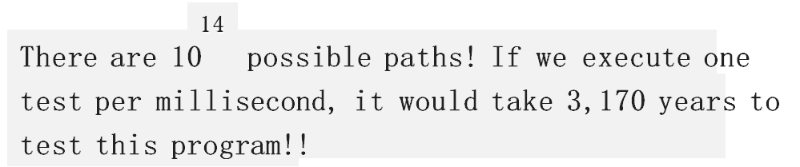
Exhaustive Testing
loop < 20 X

Slide 63
The Impossibility of
Complete Testing (Cont.)
Complete testing is impossible.
There is no simple answer for this.
There is no simple, comprehensive oracle to deal with it.
Therefore testers live and breathe tradeoffs.
Our job isn’t to design and do all the tests - it’s to choose and do the most important tests.

Slide 64
Software Testing
white-box
methods
black-box
methods
Methods
Strategies

Slide 65


White-Box Testing

Slide 66
Black-Box Testing
requirements
output
input
events

Slide 67
Fundamental Testing Techniques/Methods
Black Box/(functional) Testing
  How well the module meets its specification
  The module is looked at from outside.
  The focus is on inputs to and outputs from, and the functions that are to be carried out by the module.
White Box/(glass box, structural) Testing
  Testing a program using a knowledge of the internal workings of the program is known as “white box testing”.

Slide 68
Black-Box Testing
  knowing the specified function a product is to perform and demonstrating correct operation based solely on its specification without regard for its internal logic
Black-Box Testing/Behavioural Testing focuses on the functional requirements of the software.
Black-Box testing/behavioural is not an alternative to White-Box testing but a complementary approach to uncover a different class of errors than White-Box testing does.

Slide 69
Black-Box Testing (Cont.)
How is functional validity tested?
How is system behavior and performance tested?
What classes of input will make good test cases?
Is the system particularly sensitive to certain input values?
How are the boundaries of a data class isolated?
What data rates and data volume can the system tolerate?
What effect will specific combinations of data have on system operation?

Slide 70
Black Box Testing: Introduction
Test Engineers have no access to the source code or documentation of internal working.
The “Black Box” can be:
  A single unit.
  A subsystem.
  The whole system.
Tests are based on:
  Specification of the “Black Box”.
  Providing inputs to the “Black Box” and inspect the outputs.
Inputs
Component Under Test
Outputs
CPSC-4360-01, CPSC-5360-01, Lecture 12

Slide 71
Test Case Design
Two techniques will be covered for the black box testing in this course:
  Equivalence Partition;
  Boundary Value Analysis.
CPSC-4360-01, CPSC-5360-01, Lecture 12

Slide 72
Equivalence Partition: Introduction
To ensure the correct behavior of a “black box”, both valid and invalid cases need to be tested.
Example:
  Given the method below:
boolean isValidMonth(int m)
Functionality: check m is [1..12]
Output:
- true if m is 1 to 12
- false otherwise
Is there a better way to test other than testing all integer values [-2³¹, …, 2³¹-1] ?
CPSC-4360-01, CPSC-5360-01, Lecture 12

Slide 73
Equivalence Partition
Experience shows that exhaustive testing is not feasible or necessary:
  Impractical for most methods.
  An error in the code would have caused the same failure for many input values:
    There is no reason why a value will be treated differently from others.
    E.g., if value 240 fails the testing, it is likely that 241 is likely to fail the test too.
A better way of choosing test cases is needed.
CPSC-4360-01, CPSC-5360-01, Lecture 12

Slide 74
Equivalence Partition
Observations:
  For a method, it is common to have a number of inputs that produce similar outcomes.
  Testing one of the inputs should be as good as exhaustively testing all of them.
  So, pick only a few test cases from each “category” of input that produce the same output.
1, 5, 9,
11, 12
isValidMonth( int m )
TRUE
All inputs here produce TRUE.
CPSC-4360-01, CPSC-5360-01, Lecture 12

Slide 75
Equivalence Partition: Definition
Partition input data into equivalence classes.
Data in each equivalence class:
  Likely to be treated equally by a reasonable algorithm.
  Produce same output state, i.e., valid/invalid.
Derive test data for each class.
Input Test Data
Component
Result
CPSC-4360-01, CPSC-5360-01, Lecture 12

Slide 76
Example (isValidMonth)
For the isValidMonth example:
  Input value [1 … 12] should get a similar treatment.
  Input values lesser than 1, larger than 12 are two other groups.
Three partitions:
  [ -∞ ... 0 ] should produce an invalid result
  [ 1 … 12 ] should produce a valid result
  [ 13 … ∞ ] should produce an invalid result
Pick one value from each partition as test case:
  E.g., {-12, 5, 15}
  Reduce the number of test cases significantly.
CPSC-4360-01, CPSC-5360-01, Lecture 12

Slide 77
Common Partitions
If the component specifies an input range, [ X … Y ].
  Three partitions:
-∞ ... <X
X ... Y
>Y … ∞
Invalid
Valid
Invalid
If the component specifies a single value, [ X ].
  Three partitions:
-∞ ... <X
X
>X … ∞
Invalid
Valid
Invalid
CPSC-4360-01, CPSC-5360-01, Lecture 12

Slide 78
Boundary Value Analysis: Introduction
It has been found that most errors are caught at the boundary of the equivalence classes.
Not surprising, as the end points of the boundary are usually used in the code for checking:
  E.g., checking K is in range [ X … Y ):
Easy to make mistake on the comparison.
if (K >= X && K <= Y)
    ...
Hence, when choosing test data using equivalence classes, boundary values should be used.
Nicely complement the Equivalence Class Testing.
CPSC-4360-01, CPSC-5360-01, Lecture 12

Slide 79
Using Boundary Value Analysis
If the component specifies a range, [ X … Y ]
  Four values should be tested:
    Valid: X and Y
    Invalid: Just below X (e.g., X – 1)
    Invalid: Just above Y (e.g., Y + 1)
  E.g., [1 … 12]
    Test Data: {0, 1, 12, 13}
Similar for open interval (X … Y), i.e., X and Y not inclusive.
  Four values should be tested:
    Invalid: X and Y
    Valid: Just above X (e.g., X + 1)
    Valid: Just below Y (e.g., Y - 1)
  E.g., (100 … 200)
    Test Data: {100, 101, 199, 200}
CPSC-4360-01, CPSC-5360-01, Lecture 12

Slide 80


Example:
Factorial function: n!
Factorial
n
n!

Slide 81
Factorial of n: n!
Equivalence partitioning – break the input domain into different classes:
  Class1: n<0
  Class2: n>0 and n! doesn’t cause an overflow
  Class3: n>0 and n! causes an overflow
Boundary Value Analysis:
  n=0 (between class1 and class2)

Slide 82
Factorial of n: n!
Test cases
Test case = ( ins, expected outs)
Equivalence partitioning – break the input domain into different classes:
  From Class1: ((n = -1), “ function not defined for n negative”)
  From Class2: ((n = 3), 6)
  From Class3: ((n=100), “ input value too big”)
Boundary Value Analysis:
  ((n=0), 1)

Slide 83
White Box - testing technique
All independent paths within a module have been exercised at least once
Exercise all logical decisions on their true and false sides
Execute all loops at their boundaries and within their operational bounds
Exercise internal data structures to ensure their validity
Srihari Techsoft

Slide 84
Loop Testing
This white box technique focuses on the validity of loop constructs.
4 different classes of loops can be defined
      simple loops
      nested loops
      concatenated loops
      Unstructured loops
Srihari Techsoft

Slide 85
Other White Box Techniques
Statement Coverage – execute all statements at least once
Decision Coverage – execute each decision direction at least once
Condition Coverage – execute each decision with all possible outcomes at least once
Decision / Condition coverage – execute all possible combinations of condition outcomes in each decision.
Multiple condition Coverage – Invokes each point of entry at least once.
Examples ……
Srihari Techsoft

Slide 86
Statement Coverage – Examples
Eg. A + B
If (A = 3) Then
B = X + Y
End-If
While (A > 0) Do
    Read (X)
    A = A - 1
End-While-Do
Srihari Techsoft

Slide 87
Decision Coverage - Example
If A < 10 or A > 20 Then
B = X + Y
Condition Coverage – Example
A = X
If (A > 3) or (A < B) Then
B = X + Y
End-If-Then
While (A > 0) and (Not EOF) Do
Read (X)
A = A - 1
End-While-Do
Srihari Techsoft

Slide 88
Black box vs white box
Black box testing |  | White box testing
Criteria | Black Box Testing | White Box Testing
Definition | Black Box Testing is a software testing method in which the internal structure/ design/ implementation of the item being tested is NOT known to the tester | White Box Testing is a software testing method in which the internal structure/ design/ implementation of the item being tested is known to the tester.
Levels Applicable To | Mainly applicable to higher levels of testing:Acceptance Testing System Testing | Mainly applicable to lower levels of testing:Unit Testing Integration Testing
Responsibility | Generally, independent Software Testers | Generally, Software Developers
Programming Knowledge | Not Required | Required
Implementation Knowledge | Not Required | Required
Basis for Test Cases | Requirement Specifications | Detail Design

Slide 89
Sanity testing
  Initial effort to determine if a new software version is performing well enough to accept it for a major testing effort.
Regression testing
  Re-testing after fixes or modifications of the software or its environment.
Srihari Techsoft

Slide 90
Acceptance testing
  Final testing based on specifications of the end-user or customer
Load testing
  Testing an application under heavy loads.
  Eg. Testing of a web site under a range of loads to determine, when the system response time degraded or fails.
Srihari Techsoft

Slide 91
Stress Testing
  Testing under unusually heavy loads, heavy repetition of certain actions or inputs, input of large numerical values, large complex queries to a database etc.
  Term often used interchangeably with ‘load’ and ‘performance’ testing.
Performance testing
  Testing how well an application complies to performance requirements.
Srihari Techsoft

Slide 92
Install/uninstall testing
  Testing of full,partial or upgrade install/uninstall process.
Recovery testing
  Testing how well a system recovers from crashes, HW failures or other problems.
Compatibility testing
  Testing how well software performs in a particular HW/SW/OS/NW environment.
Srihari Techsoft

Slide 93
Exploratory testing / ad-hoc testing
  Informal SW test that is not based on formal test plans or test cases; testers will be learning the SW in totality as they test it.
Comparison testing
  Comparing SW strengths and weakness to competing products.
Srihari Techsoft

Slide 94
Alpha testing
  Testing done when development is nearing
  completion; minor design changes may still be made as a result of such testing.
Beta-testing
  Testing when development and testing are essentially completed and final bugs and problems need to be found before release.
Srihari Techsoft

Slide 95
Mutation testing
  To determining if a set of test data or test cases is useful, by deliberately introducing various bugs.
  Re-testing with the original test data/cases to determine if the bugs are detected.
Srihari Techsoft

Slide 96
TEST PLAN
Objectives
To create a set of testing tasks.
Assign resources to each testing task.
Estimate completion time for each testing task.
Document testing standards.
Srihari Techsoft

Slide 97
A document that describes the
  scope
  approach
  resources
  schedule
…of intended test activities.
Identifies the
  test items
  features to be tested
  testing tasks
  task allotment
  risks requiring contingency planning.

Slide 98
Purpose of preparing a Test Plan
Validate the acceptability of a software product.
Help the people outside the test group to understand ‘why’ and ‘how’ of product validation.
A Test Plan should be
  thorough enough (Overall coverage of test to be conducted)
  useful and understandable by the people inside and outside the test group.
Srihari Techsoft

Slide 99
Scope
The areas to be tested by the QA team.
Specify the areas which are out of scope (screens,
database, mainframe processes etc).
Test Approach
Details on how the testing is to be performed.
Any specific strategy is to be followed for
testing (including configuration management).
Srihari Techsoft

Slide 100
Entry Criteria
Various steps to be performed before the start of a test i.e. Pre-requisites.
E.g.
  Timely environment set up
  Starting the web server/app server
  Successful implementation of the latest build etc.
Resources
List of the people involved in the project and their designation etc.
Srihari Techsoft

Slide 101
Tasks/Responsibilities
Tasks to be performed and responsibilities assigned to the various team members.
Exit Criteria
Contains tasks like
Bringing down the system / server
Restoring system to pre-test environment
Database refresh etc.
Schedule / Milestones
Deals with the final delivery date and the various milestones dates.
Srihari Techsoft

Slide 102
Hardware / Software Requirements
Details of PC’s / servers required to install the
application or perform the testing
Specific software to get the application
running or to connect to the database etc.
Risks & Mitigation Plans
List out the possible risks during testing
Mitigation plans to implement incase the risk
actually turns into a reality.
Srihari Techsoft

Slide 103
Tools to be used
List the testing tools or utilities
Eg.WinRunner, LoadRunner, Test Director, Rational Robot, QTP.
Deliverables
Various deliverables due to the client at various
points of time i.e. Daily / weekly / start of the
project end of the project etc.
These include test plans, test procedures, test
metric, status reports, test scripts etc.
Srihari Techsoft

Slide 104
Good Test Plans
Developed and Reviewed early.
Clear, Complete and Specific
Specifies tangible deliverables that can be inspected.
Staff knows what to expect and when to expect it.
Srihari Techsoft

Slide 105
Good Test Plans
Realistic quality levels for goals
Includes time for planning
Can be monitored and updated
Includes user responsibilities
Based on past experience
Recognizes learning curves
Srihari Techsoft

